Slide 1

Appium: Introduction | What is Appium | How Appium Works
By: Damaris Saavedra
Mon Aug 1 2022

Slide 2

Learn
What we will learn: what is Appium
Why Appium is the preferred choice
How Appium works
Different types of mobile apps
Setup Possibilities with Appium
Appium: is an open source tool or automate narrative native, hybrid and mobile applications
It’s a cross platform: Android, iOS, Windows.

Slide 3
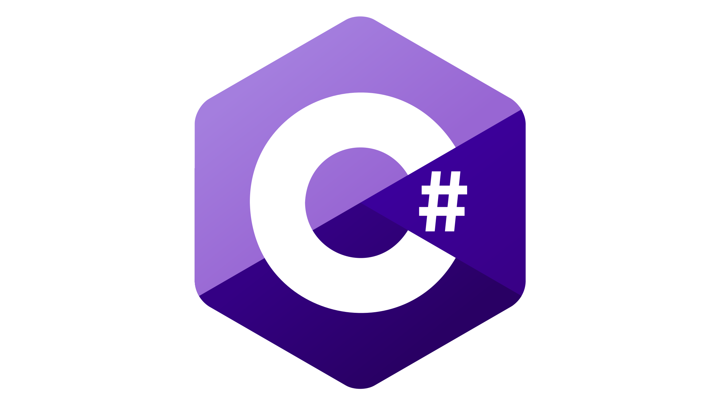





Supports multiple programming languages which are supported by Selenium
Java
JavaScript
Ruby
Phyton
C-Sharp

Slide 4

Nice to know
Selenium is an opensource umbrella project for a range of tools and libraries aimed at supporting browser automation.
Difference between Selenium and Appium
Appium is used for automated testing applications on a mobile device, including mobile application versions, mobile browser application versions, native and Hybrid. On the other hand, Selenium is used for test automation of web pages and does not support system & mobile applications.

Slide 5
Alternative tools
APPIUM | XCTEST | ROBOTIUM | UI AUTOMATOR | EXPRESSO
iOS/Android | iOS | Android | Android | Android
Unit Tests | Unit Tests | Unit Tests | Unit Tests | Unit Tests
Functional Tests | Functional Tests | Functional Tests | Functional Tests | Functional Tests
Multi Language | Objective C or Swift

Slide 6
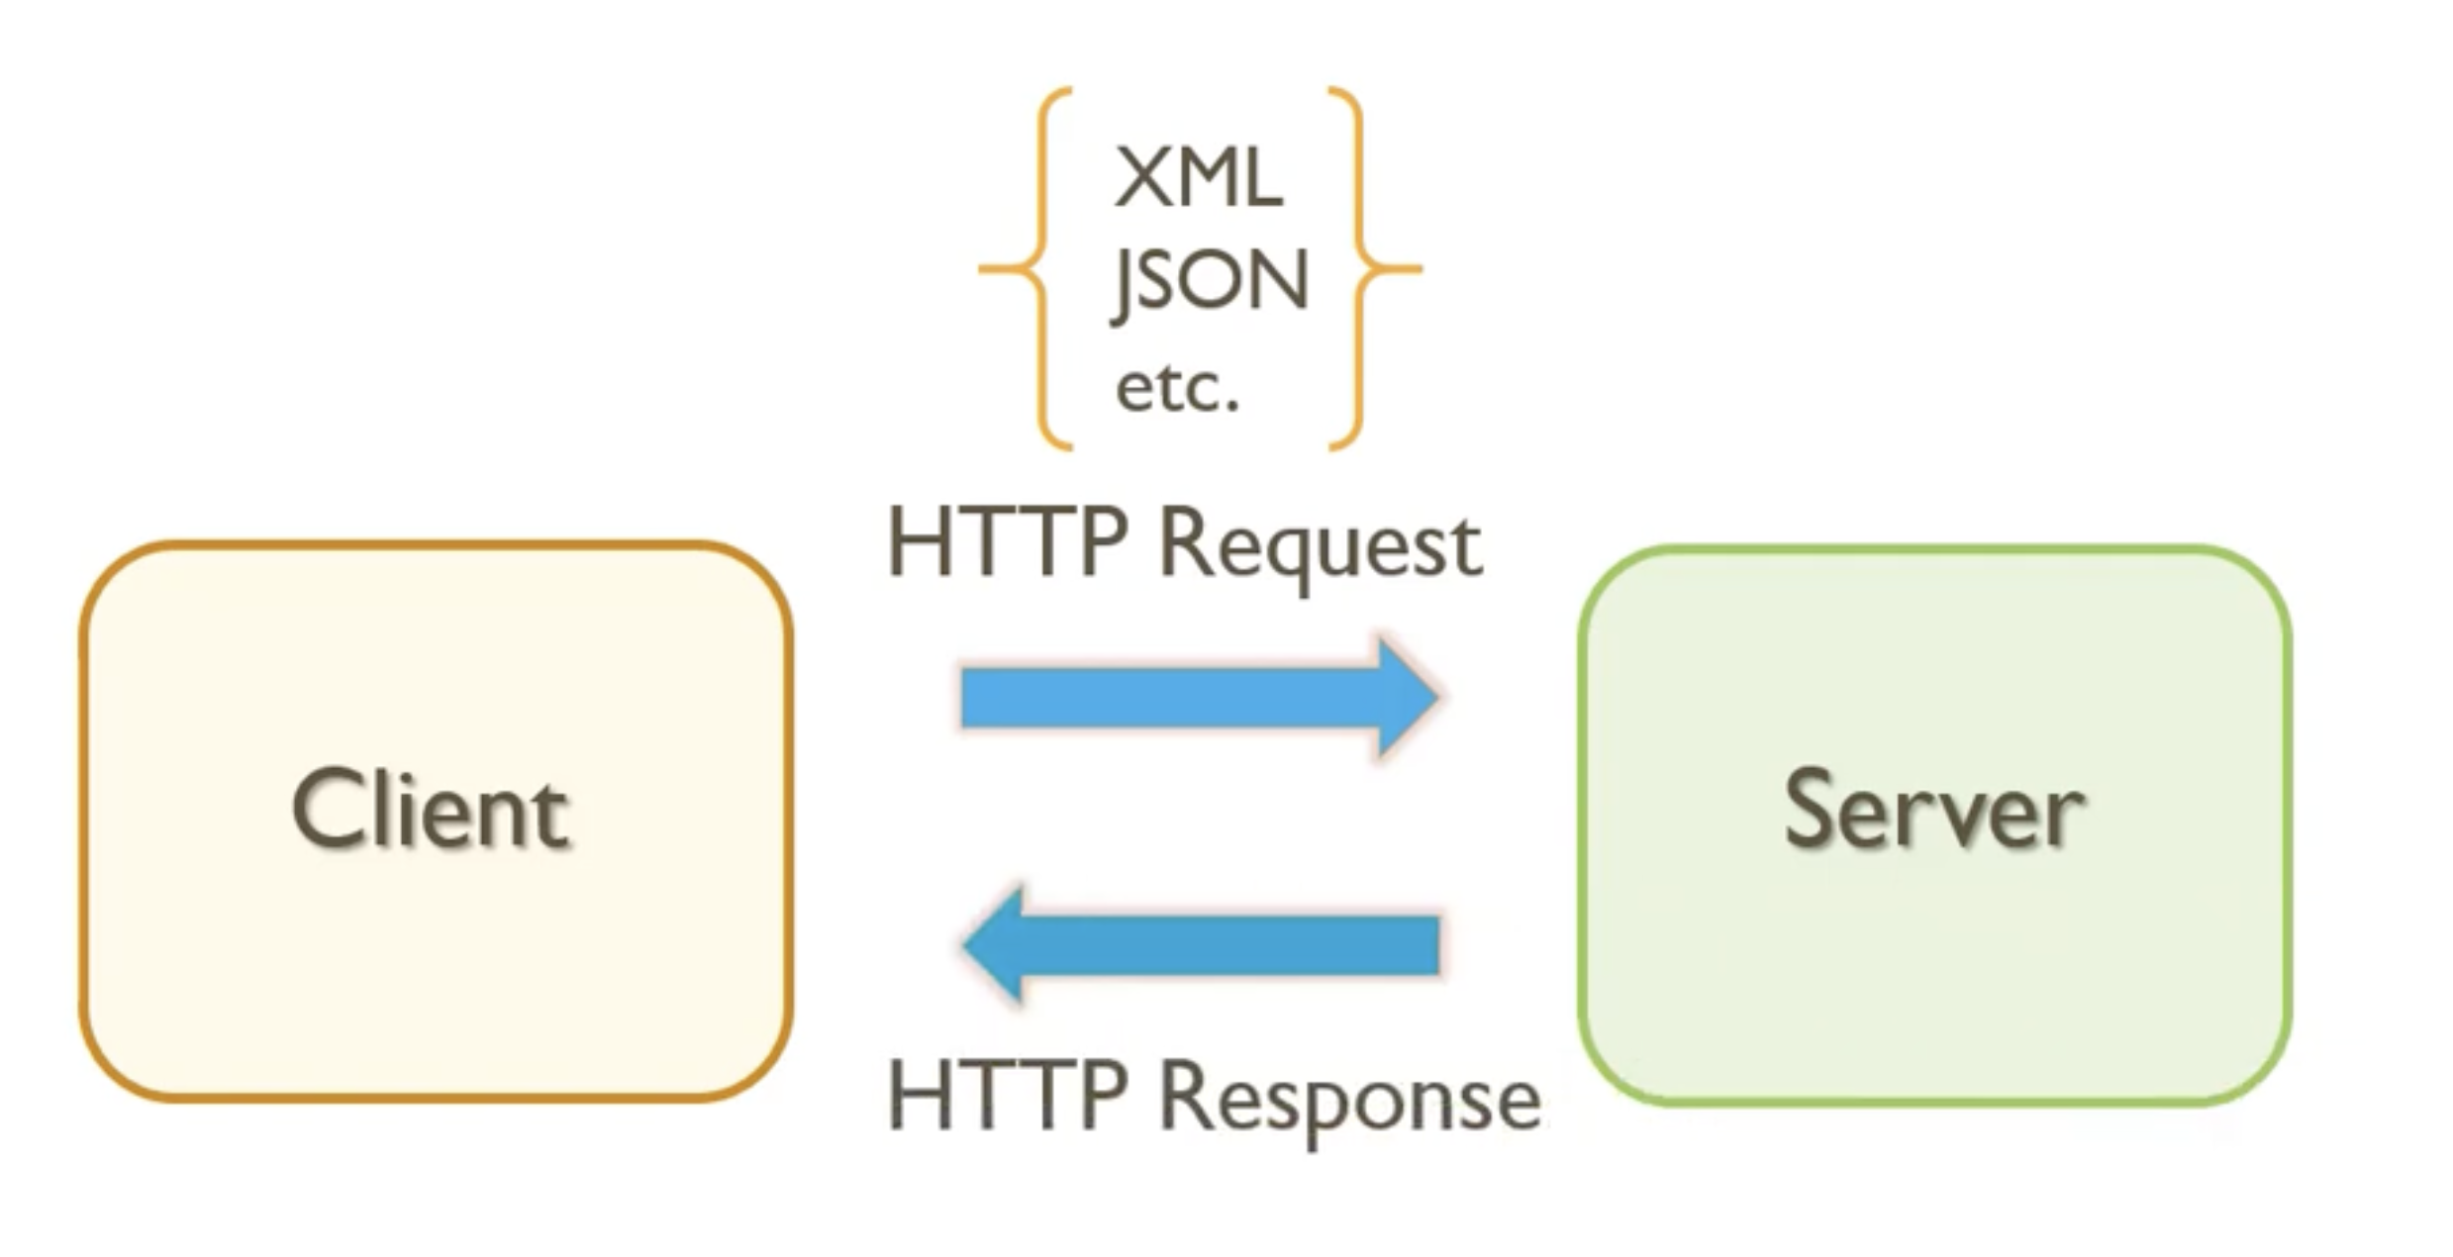
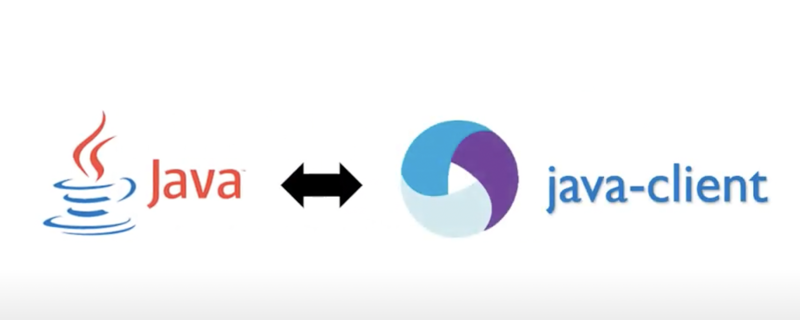
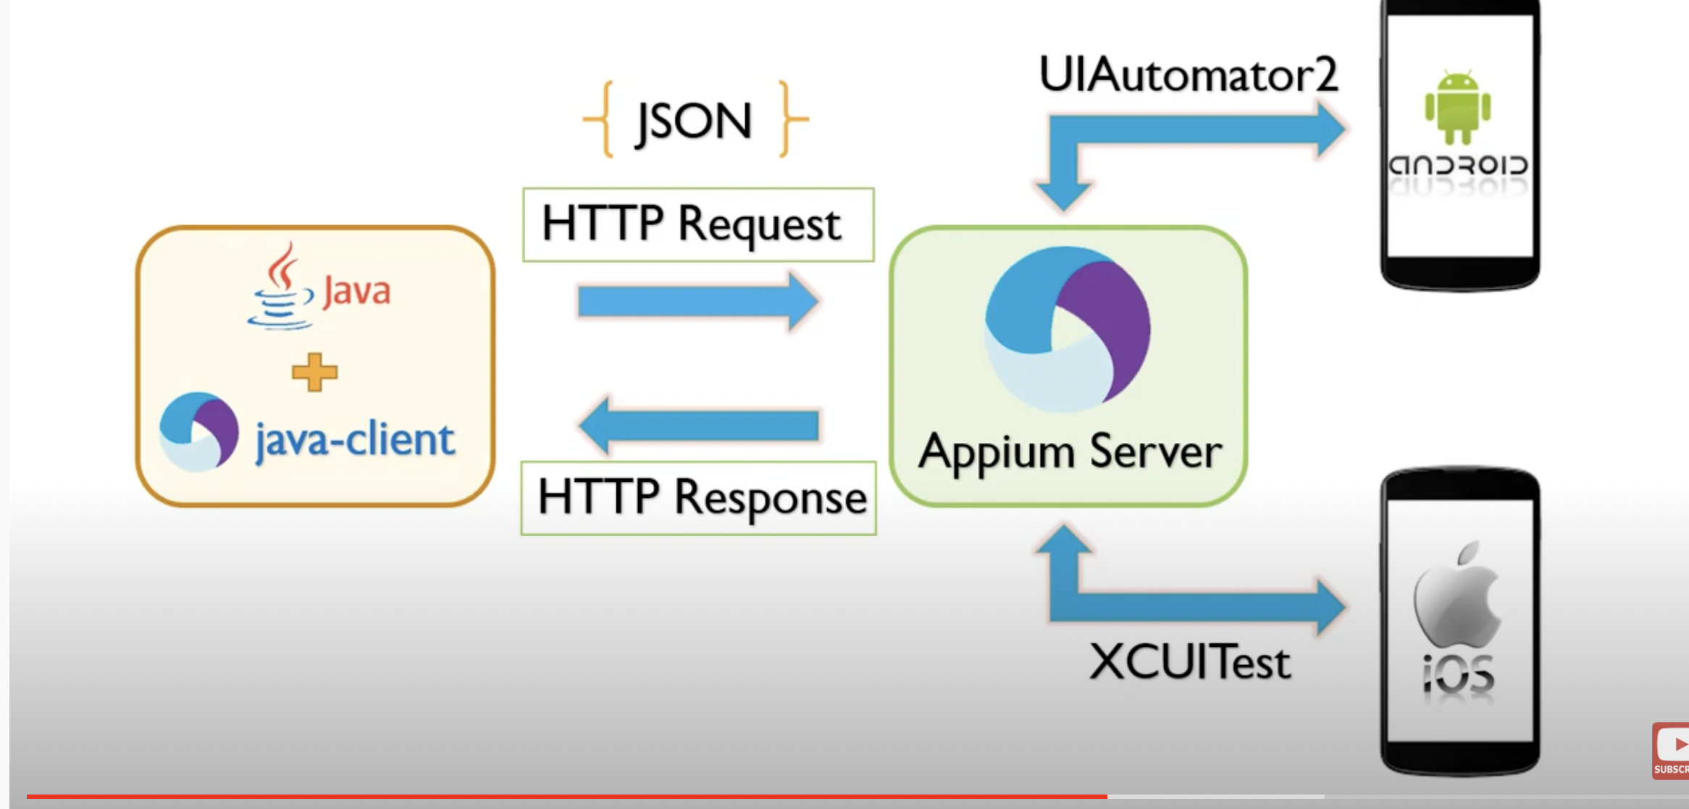
LIMITATIONS & HOW IT WORKS
Apple framework changes and iOS limitations does impact Appium
Cannot scale, mainly due to restrictions around ios, mounting local server
Appium uses Selenium’s WebDriver API
What is API? Is based on JSON Wire Protocol
Appium developed Client libraries that implements JSON Wire Protocol for Mobile
You can download and use the java client library in your automation framework

Slide 7
Native Apps and Hybrid apps
A native mobile app is a smartphone application that is coded in a specific programming language, such as Objective C for iOS or Java for Android operating systems. Native mobile apps provide fast performance and a high degree of reliability
Native apps are build with their native code.
Example iOS= Swift
Android = Java
If you use a framework like ionic at the end it will give you the result of an hybrid application. When you compile the app it will interpret this as their native language. Example you can program in any programming language and it will give you the result of an iOS native app.

Slide 8
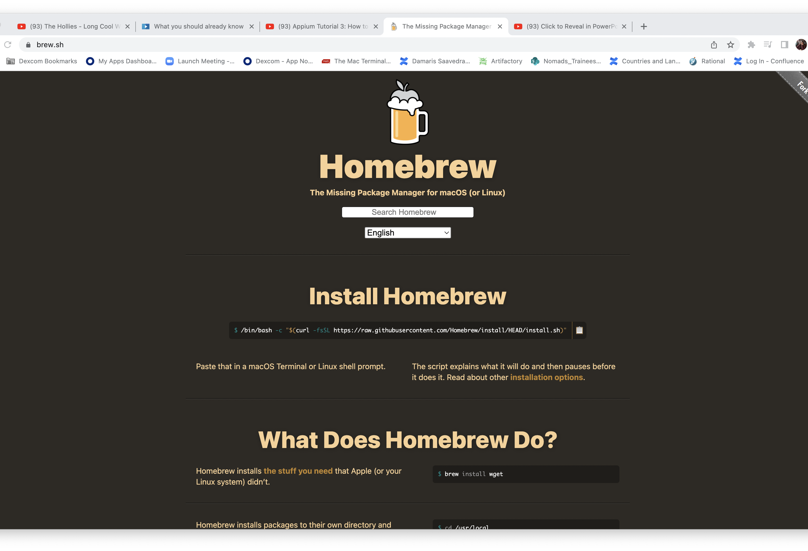
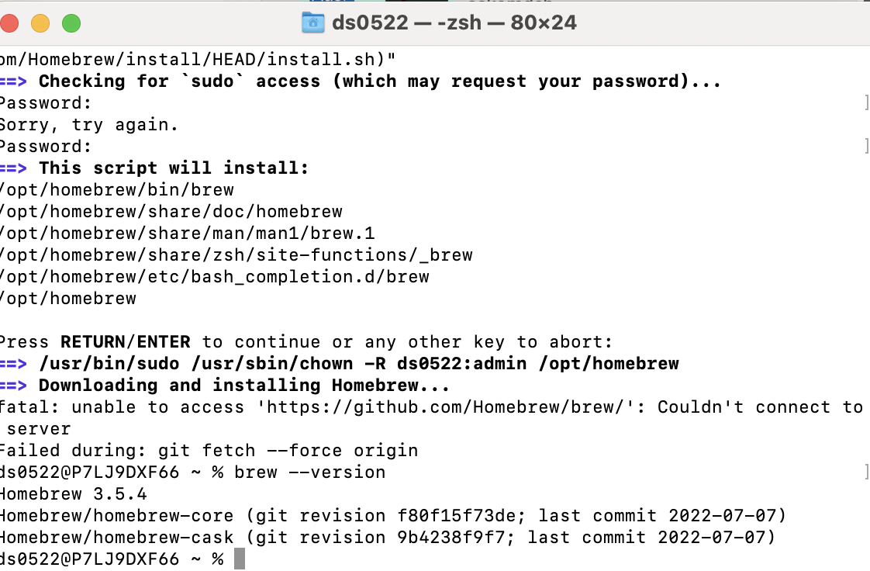
Appium Tutorial 3: How to setup Appium on MAC for iOS
We need a Mac and iPhone connected
First thing we need
Homebrew: Homebrew is a free and open-source software package management system that simplifies the installation of software on Apple's operating system, macOS, as well as Linux.
Copy the command and paste it in the terminal

Slide 9
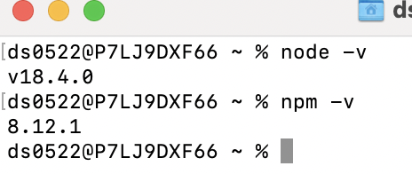
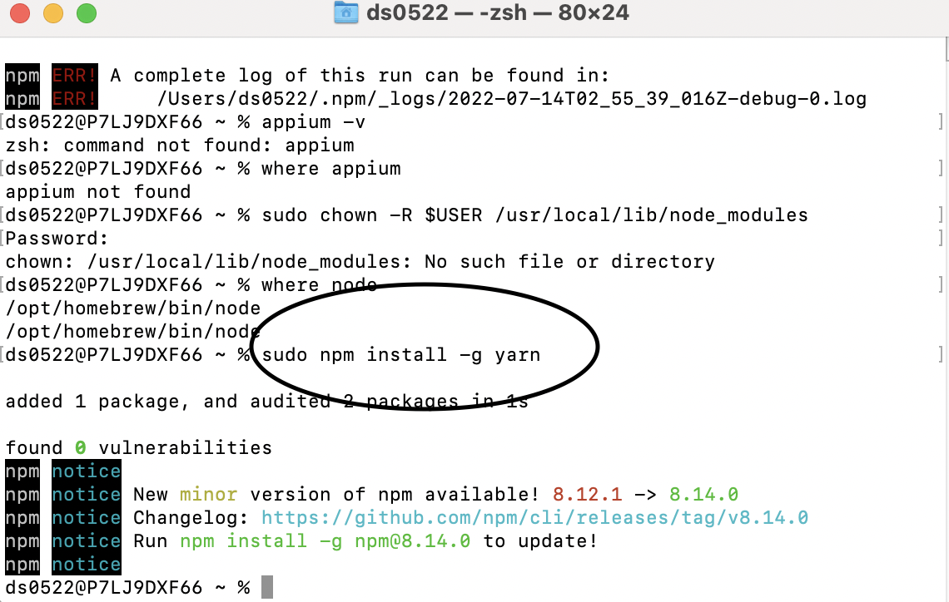
Install Appium
Via. NPM:
NPM is a package manager for node
Command to install node: brew install node
Command to install Appium: npm install -g Appium
Via. Appium Desktop:
Download link: https://Appium.io

Slide 10
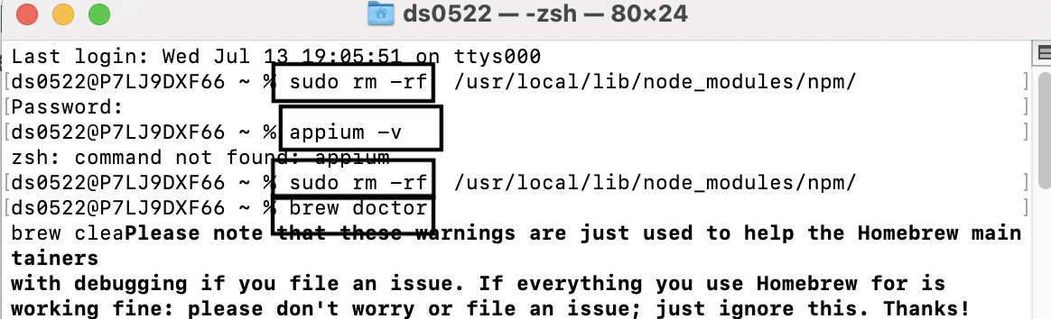
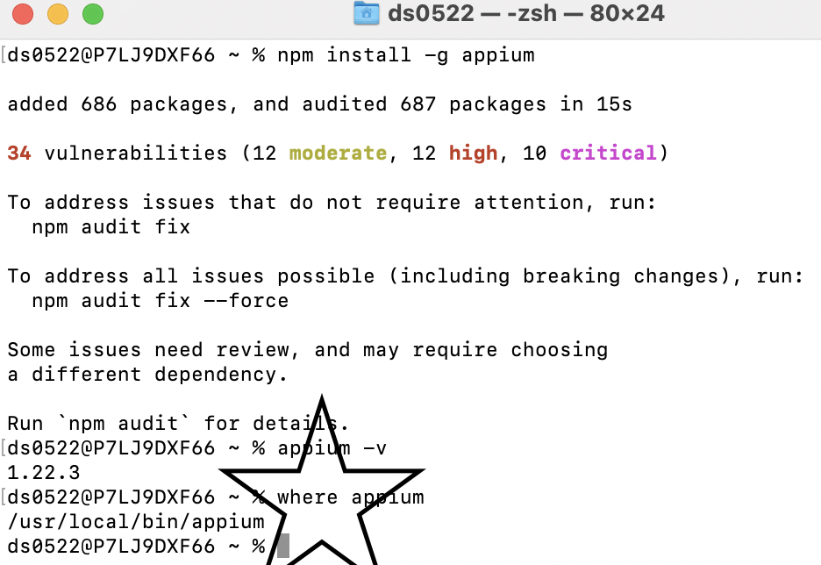
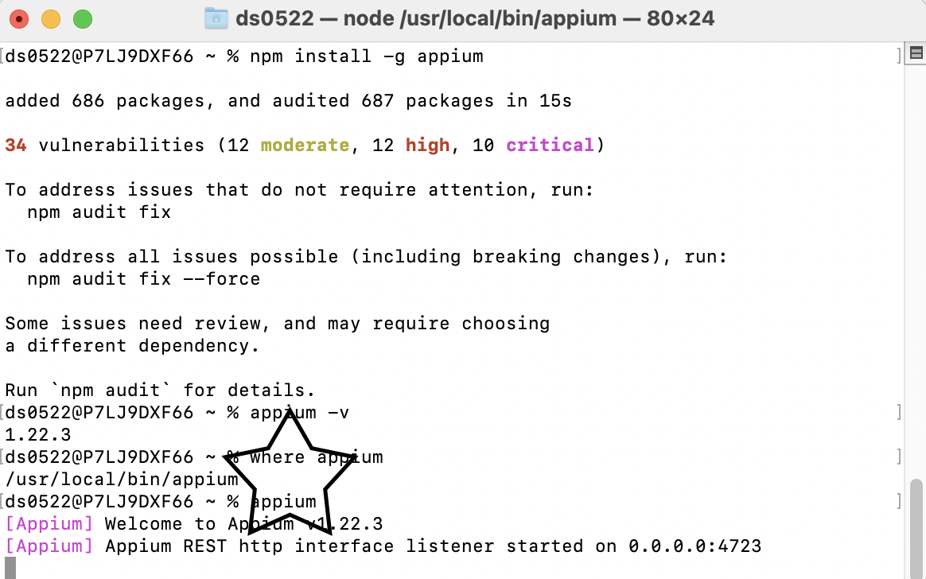
Appium issues
My computer was not installing Appium it was showing error issues
1. sudo rm -rf /usr/local/lib/node_modules/npm/ 2. brew doctor 3. brew cleanup --prune-prefix ( or sudo rm -f /usr/local/include/node) 4. brew install node
(re install Appium)
At the the end run the command Appium to start the Appium server

Slide 11
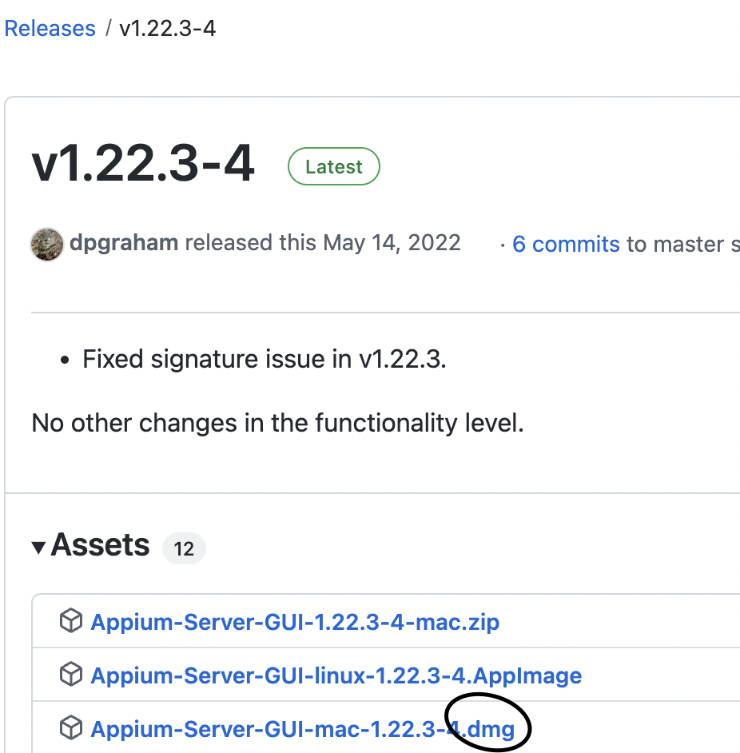
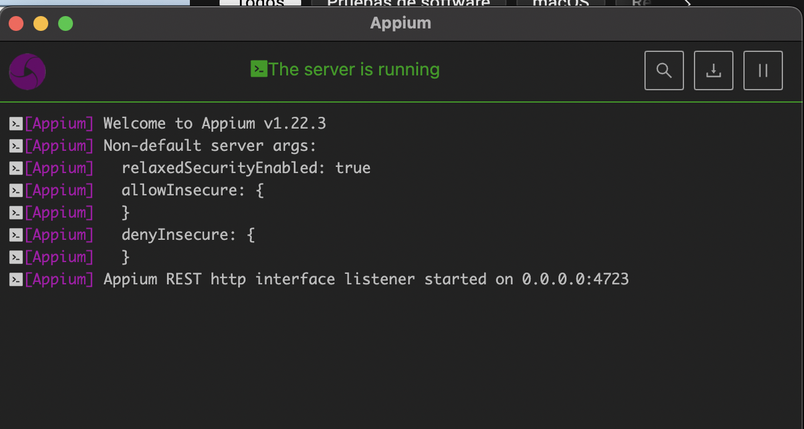
Go to https://appium.io/
Click on download and choose dmg file

Slide 12
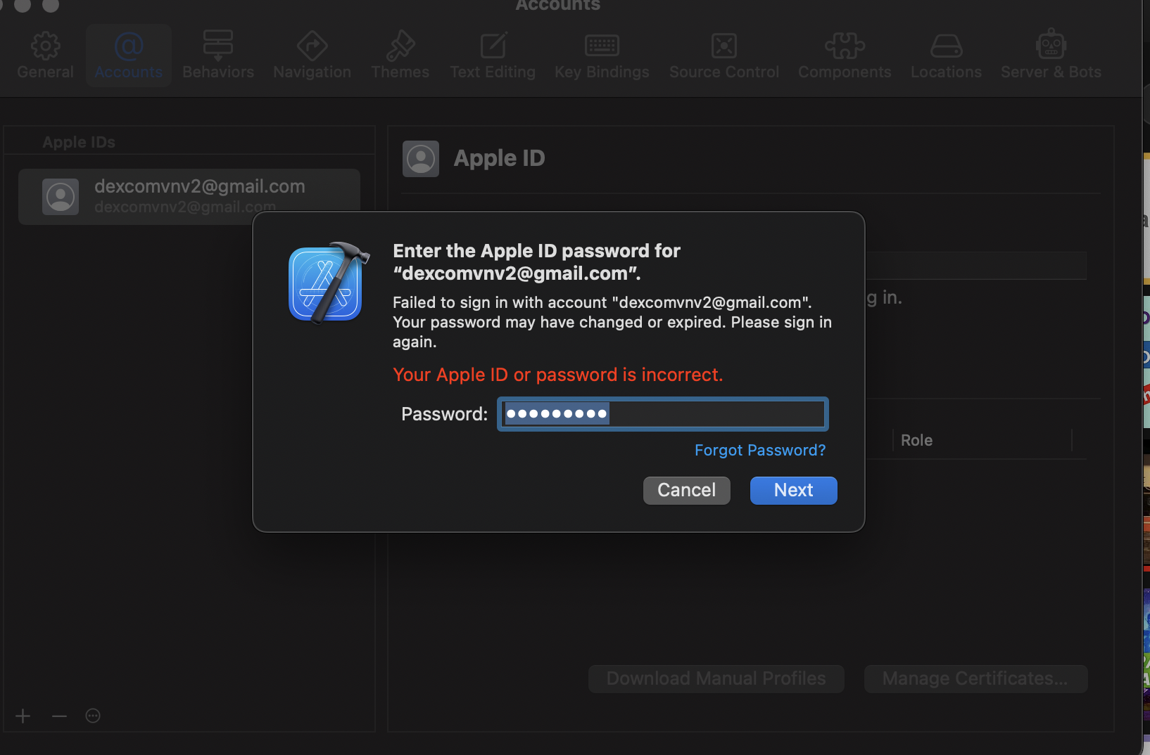
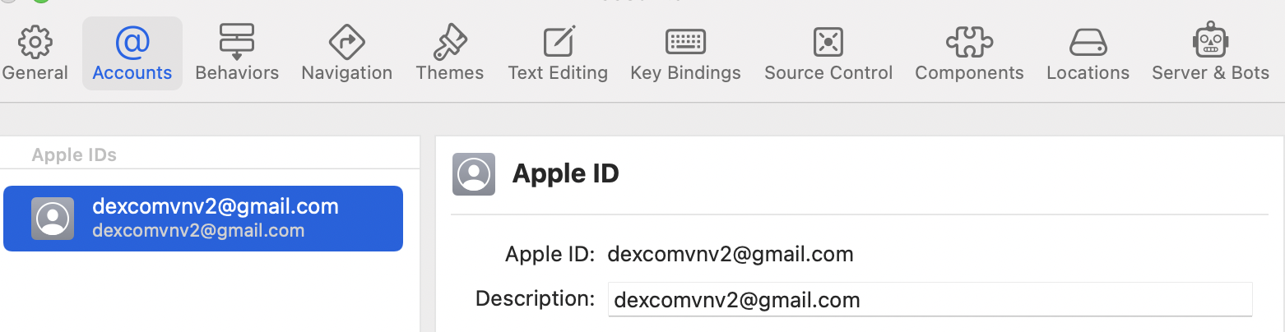
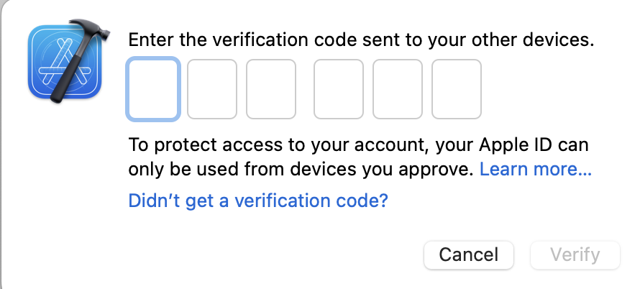
Install xcode
In my case xcode was already installed, I just needed to check that the configurations where properly setup, the only issue I had was not knowing the password for the default acct we created for xcode, it was something I could easily get through slack channels.
My buddy provided the password and added me to the apps_and_test_fw_team
to get the verification code code

Slide 13
How to setup Appium on Mac for Android
1 Install homebrew
Link: https://brew.sh/
Run Command /bin/bash -c "$(curl -fsSL https://raw.githubusercontent.com/Homebrew/install/HEAD/install.sh)"
2 Install node and npm (Appium dependencies)
Commands to check if node and npm are installed:
node –v
npm –v
Command to install node: brew install node (this will install npm as well)
Command to check node installation path: where node
3 Install Appium server using NPM
Command to install Appium: npm install –g Appium
Command to check Appium version: appium –v
Command to check Appium installation path: where Appium
Or Install Appium server using Appium Desktop Client
Download link: https://Appium.io
4 Install JAVA JDK (not the JRE!)
5 Install Android Studio
6 Set JAVA_HOME and ANDROID_STUDIO in the .bash_profile file
7 Verify installation using Appium-doctor
8 Create AVD and start it [Emulator Setup]
9 Enable usb Debugging on Android mobile [Real Device setup]
10 Test Appium server connection by launching a demo app on Android device

Slide 14
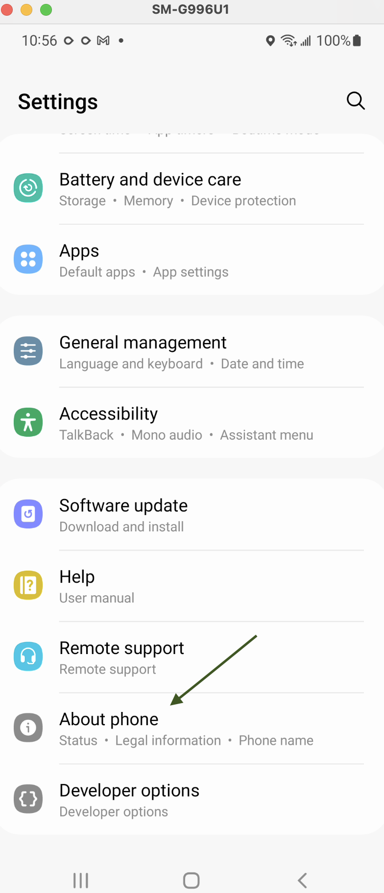
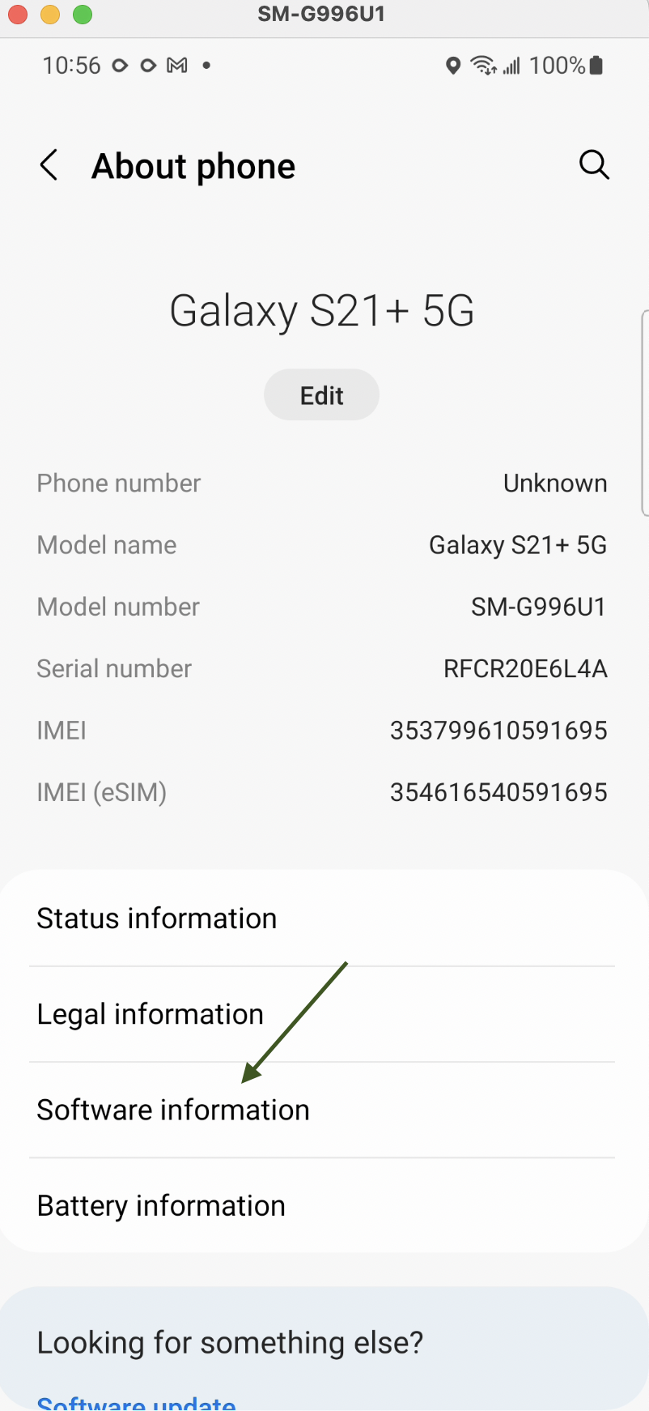
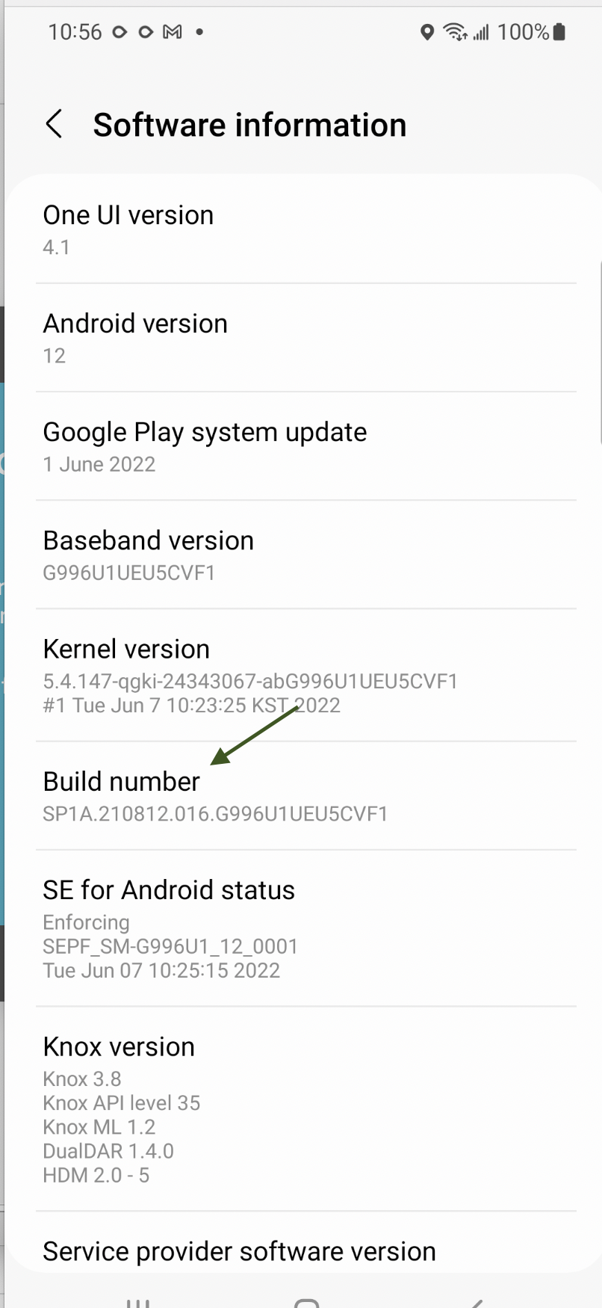
First Java Project for Android

Slide 15
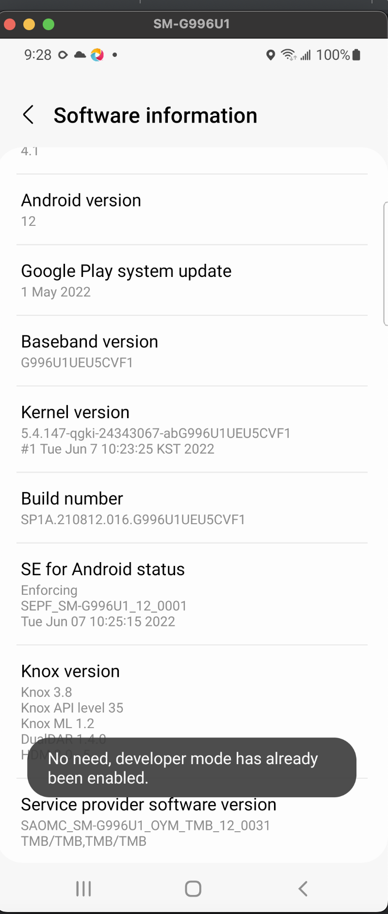
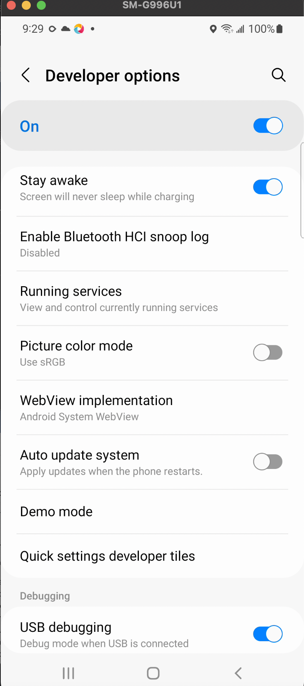
First Java Project for Android
Prerequisite: Appium server is installed and the environment is configured for Android
Choose developer mode for Android
Open docker, turn on containers
Verify Localhost
IntelliJ

Slide 16
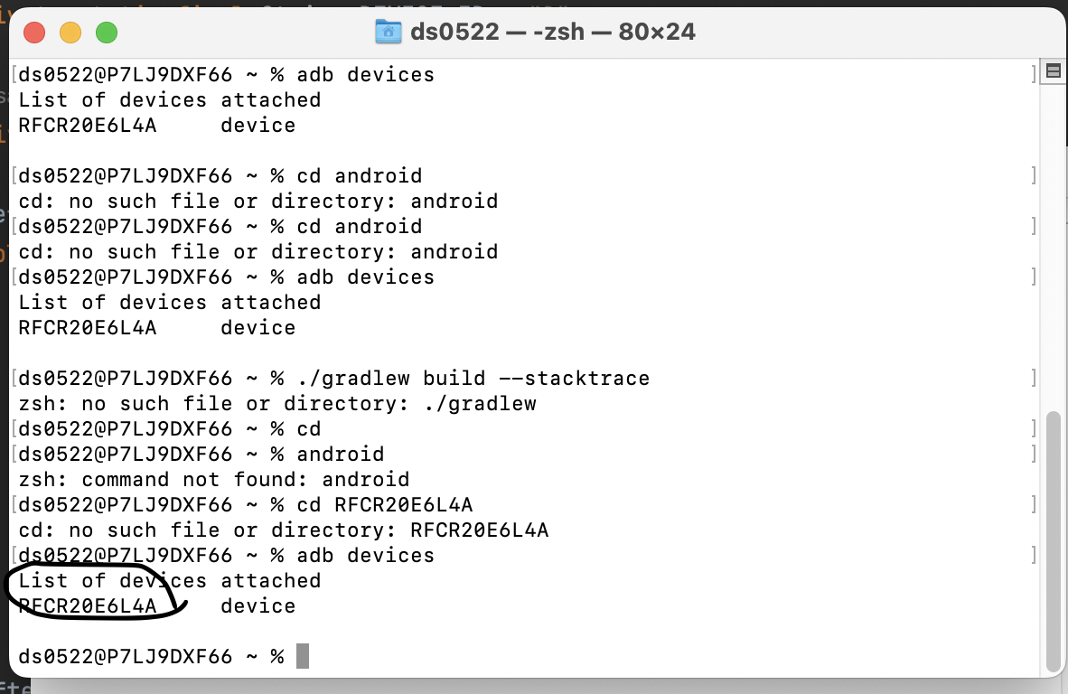
Make sure to get the Device ID

Slide 17
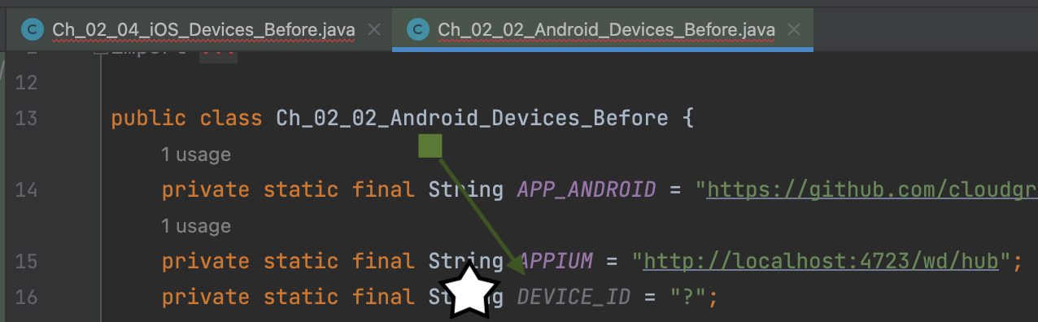
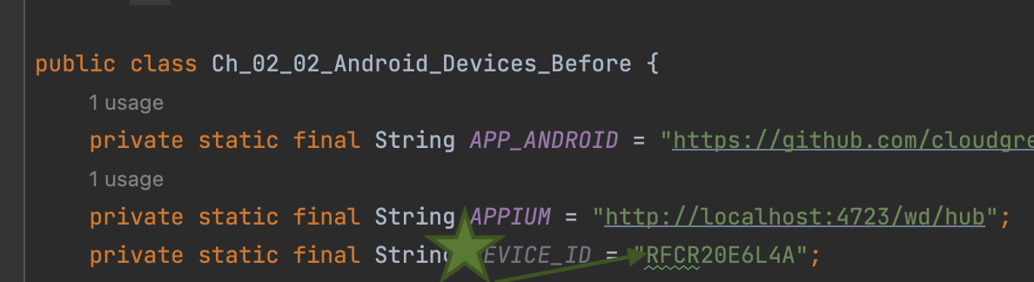
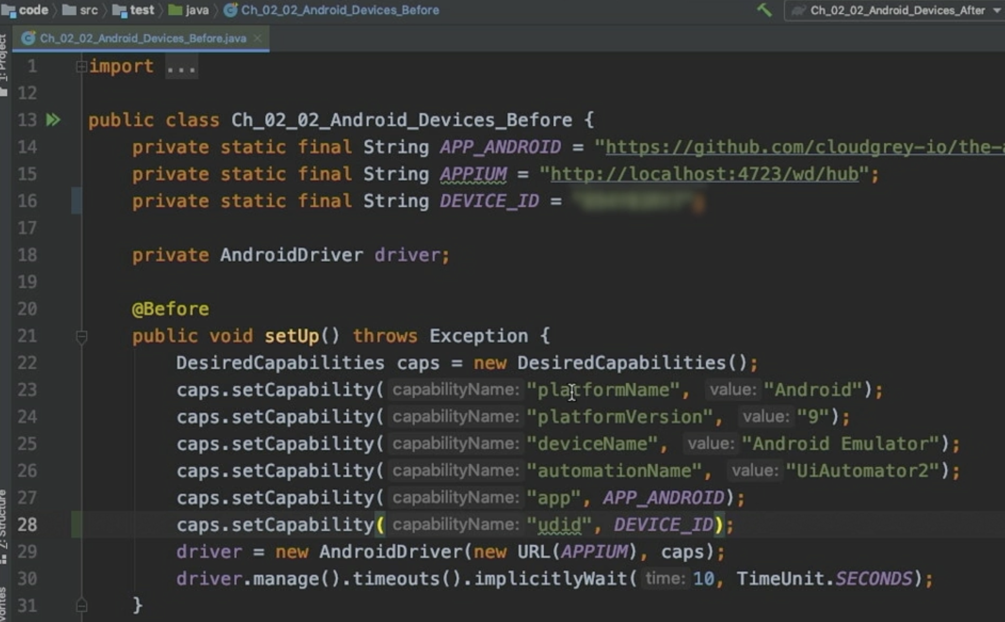
To make sure Appium has access to this ID, we need to add a new capability in our setup block

Slide 18
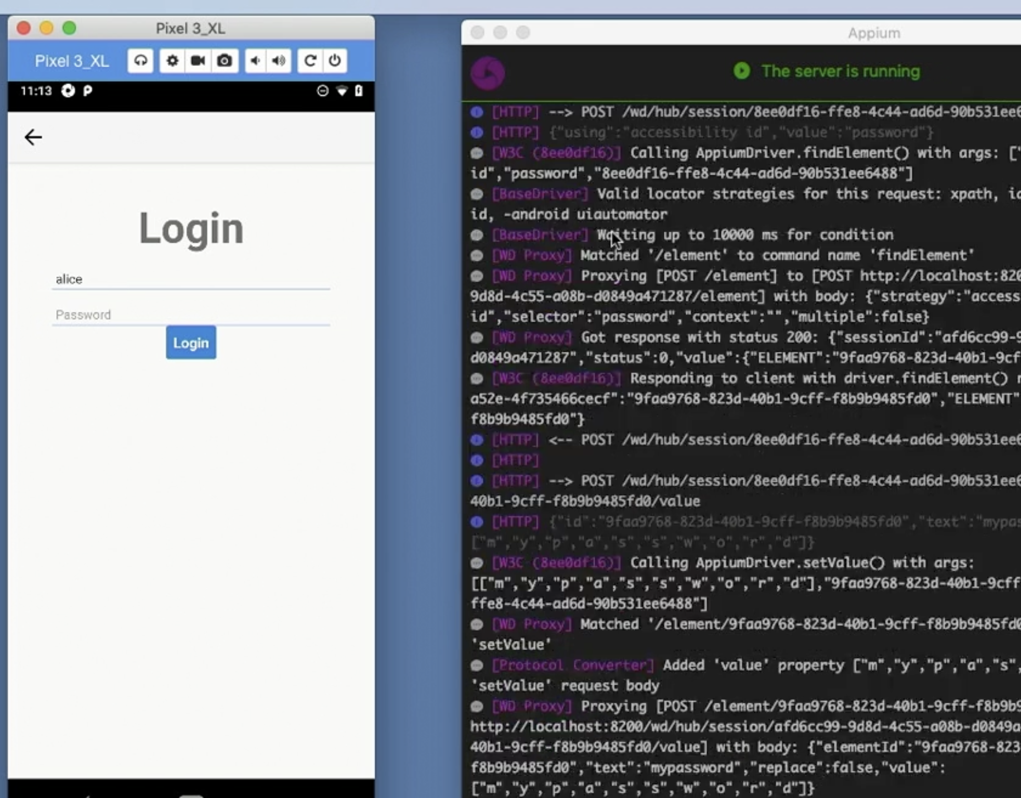
Appium will lunch the application on real device or an emulator, Appium automate its steps on a real, physical device

Slide 19


To be continued

